Slide 1
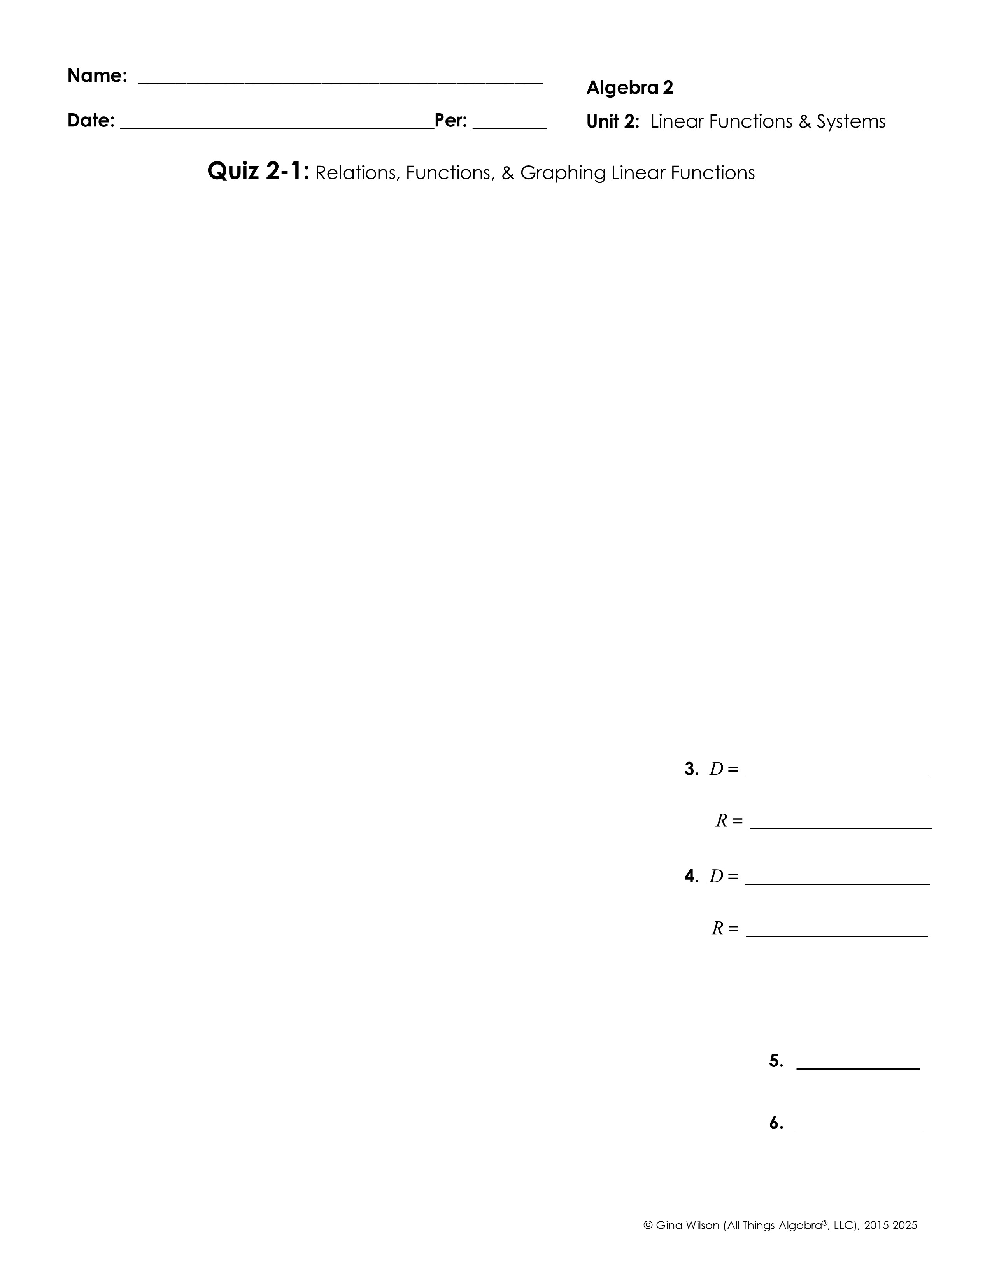
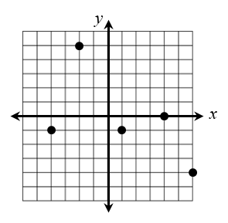
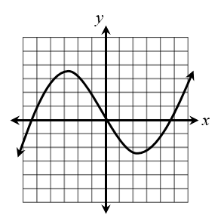
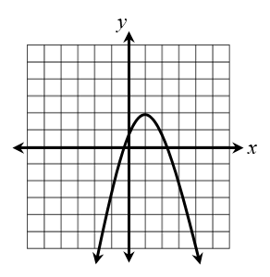
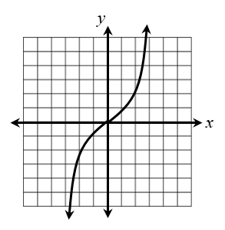
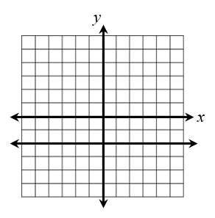
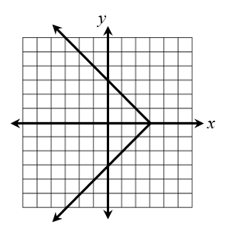
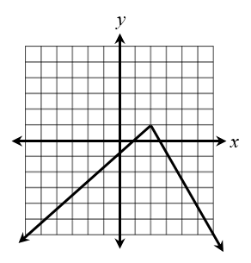
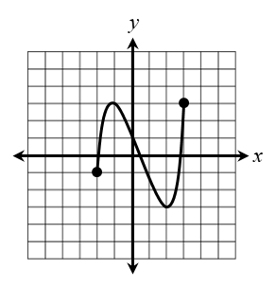
1. Which relations represent a function? Check all that apply.
x | y
-8 | 1
-7 | 1
-6 | 1
-5 | 1
x
y
-7
-4
0
8
0
5
9
2. Which graph does not represent a function?
A. B.
C.
D.
Give the domain and range of each relation below.
3. 4.
Use the functions , g(x) = |-3x + 16|, and h(x) = -x² + 8x for the questions 5 and 6.
5. Find
6. Find g(20) + h(7)

Slide 2

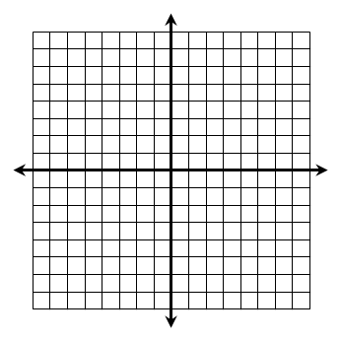
Use the functions , g(x) = |-3x + 16|, and h(x) = -x² + 8x for the questions 7 and 8.
7. If f(x) = -53, find x. 8. If g(x) = 17, find x.
For questions 9 and 10, (a) write the equation in slope-intercept form, then (b) graph the line.
9. x – 4y = 28
a) __________________________
10. 9y – 36 = -15x
a) __________________________
b)
b)
For questions 11 and 12, (a) give the x- and y-intercepts of the function, then (b) graph the line.
11. y = -6x – 5
a) x-intercept: _______________
12.
a) x-intercept: _______________
y-intercept: _______________
y-intercept: _______________
b)
b)

